Slide 1

CS220 Computer Architecture Digital Logic Design
Lecturer: Dermot Kelly
Email and Teams Chat: dermot.kelly@mu.ie
Office: Room 125 1st Floor Eolas Building
Lecture Times: Tuesday 4-6 John Hume Theatre 3.
Lab Times: Tuesday 11-1 EOLAS 003/04/05 (All Multimedia/Mobile/Web and CSSE “A” to “L”)
Wednesday 9-11 EOLAS 003/04/05 (CSSE “M” to “Z”)
Wednesday 11-1 EOLAS 03/04/05 (Other progs)
Most students are assigned automatically to these slots. Those with subject choices in Science and Arts may choose the slot that works with your timetable. Let me know which one by choosing your group on moodle!
Examination: 70% for exam in January, 30% for practical work. The final exam is normally held as a written exercise in an exam hall in January.

Slide 2
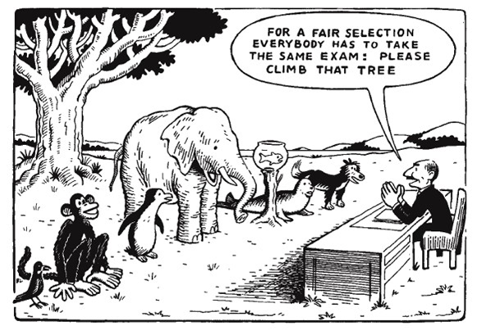
CS220 Computer Architecture Digital Logic Design
Continuous Assessment
Practicals (using circuitverse) are scheduled and assessed once only during the academic year and cannot be repeated in the same year.
Therefore it is of the utmost importance that you participate in the practicals and submit the required work and any quizzes within the designated times each week.
If you need to make any special arrangement in advance, contact me at Dermot.Kelly@mu.ie

Slide 3
CS220 Computer Architecture Digital Logic Design
Course Overview and Outcomes:
Students can expect to obtain a basic understanding of:-
How switching algebra can be used to specify designs for digital circuitry.
Formats in which data can be represented to be used in computation.
How simple digital circuits can be constructed from specifications, optimised and combined for greater complexity and capability.
How digital designs are applied to computer systems to implement basic operations of arithmetic, memory storage, sequencing, control and interfacing.

Slide 4
CS220 Computer Architecture Digital Logic Design
Detailed Topic Content - Our approach involves 3 Main Pillars or sections
1) Combinational Logic Design Boolean Algebra, Principles and Circuit Construction, Function Simplification and Substitution;
2) Sequential Logic Design Flip-Flop Based Circuits and Operating Principles, Implementing State Machines and Registers;
3) Memory Technology Memory Arrays, ECC Memories - Parity and Hamming Code Generation and Checking; Non Volatile Semiconductor Devices;
These three sections will be presented in the context of computer applications:
Application Circuits: Arithmetic and Logic Operations, Comparators, Multiplexers, Decoders, Counters, Registers and Shift Registers, Sequential Pattern Detectors;
Data Representation: Number Systems, Integer and Floating Point Representation;

Slide 5
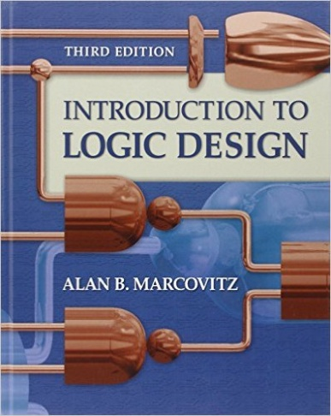
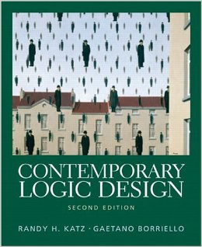
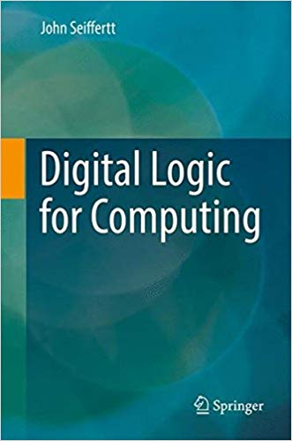
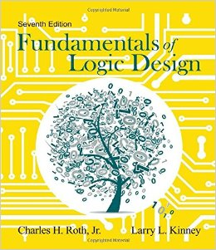
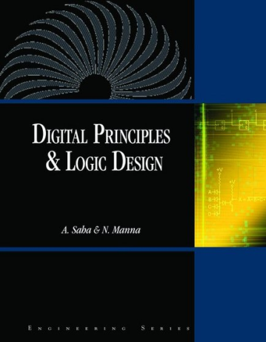
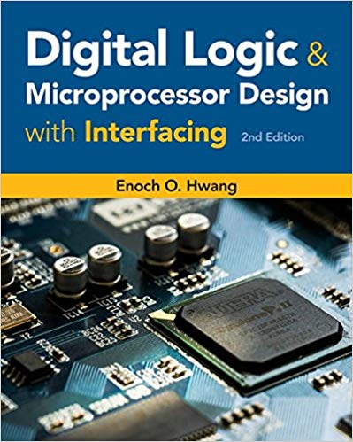
CS220 Computer Architecture Digital Logic Design
Useful reading texts covering course material
Introduction to Logic Design
A. Marcovitz
Contemporary Logic Design
R. Katz, G. Borriello
Digital Logic for Computing
John Seiffertt
Fundamentals of Logic Design
C. Roth
Digital Principles and Logic Design
A. Saha, N. Manna
Digital Logic and Microprocessor
Design with Interfacing,
Enoch Hwang

Slide 6
CS220 Computer Architecture Digital Logic Design
Where did Digital Logic Circuits come from?
Let’s look at 3 important developments in time
Boolean Algebra (1847)
Switching Theory (1938)
The Transistor (1947)

Slide 7
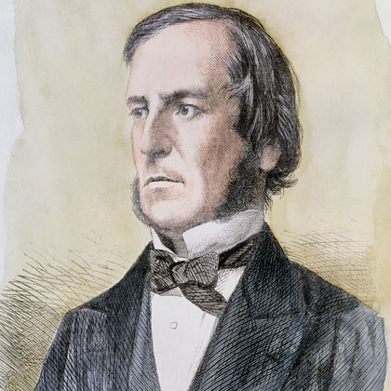
CS220 Computer Architecture Digital Logic Design
Boolean Algebra 1847
Boolean Algebra is named after the University College Cork mathematician George Boole who published his work on logic initially in 1847 in the book “The Mathematical Analysis of Logic” and later, in 1854, the more mature work “An Investigation of the Laws of Thought”. George Boole is regarded as one of the founders of the field of computer science even though computers did not exist in his time.
Boolean Algebra is a discrete algebra in which variables can have only one of two values, either TRUE or FALSE. Boolean values can be combined using the operators AND, OR and NOT, in accordance with the laws of the algebra. Like any algebra, there are also various theorems that allow manipulation and simplification of algebraic expressions.
1815 - 1864

Slide 8
CS220 Computer Architecture Digital Logic Design
Boolean Algebra
In digital logic applications of Boolean Algebra:-
A variable can have one of two values, either 1 or 0, corresponding to a switch being either on or off, 1 is represented as a “high” voltage and 0 as a “low” voltage or ‘ground’ reference.
The complement of a variable is the opposite of its current value.
That is, if X = 0, then NOT X = 1 and if X = 1, then NOT X = 0
The complement of a variable X, NOT X is usually written as X or X’
The OR operator is represented by a plus sign “+” , e.g. A + B
The AND operator is represented by a dot “.” , e.g. A.B or just AB with the dot assumed. We will present the behaviour of these operators later.

Slide 9
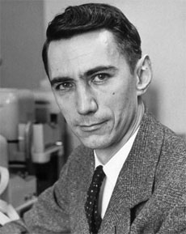
CS220 Computer Architecture Digital Logic Design
Switching Theory 1938
In his MIT Master’s Thesis of 1937/1938, the American mathematician Claude Shannon, the so-called father of information theory, used Boolean Algebra for simplifying the arrangement of relays (electromechanical switches) in telephone switching circuits.
He then reversed the concept by demonstrating that arrangements of these relays could be used to solve functional problems.
This concept, of utilizing the properties of electrical switches to compute logic functions, is the basic concept that underlies all electronic digital computers, and the thesis became the foundation of practical digital circuit design.
1916 - 2001

Slide 10
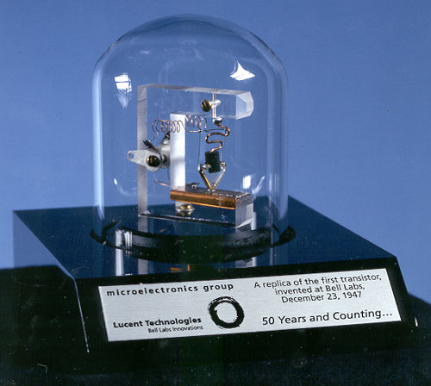
CS220 Computer Architecture Digital Logic Design
Invention of The Transistor
In 1947 the transistor was invented at Bell Laboratories.
This small semiconductor device had, amongst other applications, the ability to be used as a switch. A transistor could be used in place of a mechanical switch or magnetic relay and allowed the creation of much smaller, faster, more reliable, power efficient circuits as there are no moving parts.
Large numbers of transistors can be combined on a single semiconductor device to make complex integrated switching circuits, the first of which was developed around 1959. The first commercially produced processor, the Intel 4004 produced in 1971 had 2,300 transistors.
By comparison today, Apple’s A17 Pro processor in the latest iphones has 19 billion transistors using the latest 3nm process thanks to advancements in miniaturisation.
1947

Slide 11

CS220 Computer Architecture Digital Logic Design
Notes:
The observation made in 1965 by Gordon Moore, co-founder of Intel, that the number of transistors per square inch on integrated circuits had doubled every two years since the integrated circuit was invented. Moore predicted that this trend would continue for the foreseeable future and Intel believe it is possible it may last for another 10 years before the process of making transistors ever smaller becomes economically unviable. Pic from Wikipedia

Slide 12

CS220 Computer Architecture Digital Logic Design
Notes:
https://www.karlrupp.net/2015/06/40-years-of-microprocessor-trend-data/

Slide 13
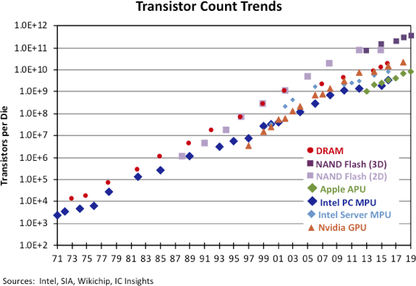
CS220 Computer Architecture Digital Logic Design
Notes:
IC Insights’ 2020 edition of The McClean Report (released in January) shows how over the past five decades, DRAMs, flash memories, microprocessors, and graphics processors have tracked the curve Moore predicted

Slide 14
CS220 Computer Architecture Digital Logic Design
Bottom up plan for today
Let’s very briefly look at the basics of how a semiconductor transistor works and can act like a switch.
Then we’ll define the behaviour of the Boolean operations more formally and show how we can implement them using configurations of transistor switches to build Logic Gates.
Next we will use combinations of these logic gates to create more complex functional circuits derived from Boolean algebra specifications.

Slide 15
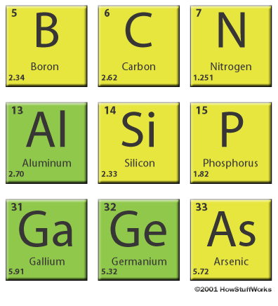
CS220 Computer Architecture Digital Logic Design
How a transistor works
A transistor is a solid state device (no moving parts) which uses a semiconductor base material of silicon or germanium. These materials are poor electrical conductors but when combined (doped) with trace amounts of elements that are their neighbours in the periodic table, like Boron or Phosphorous, they can be made conduct electricity in a controlled manner as the material’s crystals will have an imbalance in terms of electron numbers.

Slide 16
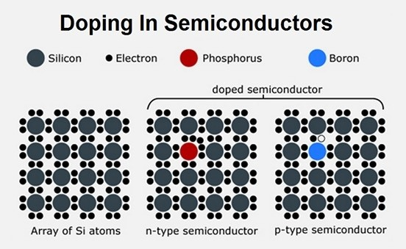
CS220 Computer Architecture Digital Logic Design
How a transistor works
Depending on what doping element is used, (Doping silicon with Phosphorous adds an electron creating n-type silicon, doping with Boron adds a hole for an electron and creates p-type silicon) there is either an excess or a shortage of electrons. If there is a shortage of electrons the material is known as p-type, if there is an excess of electrons, the material is known as n-type.

Slide 17
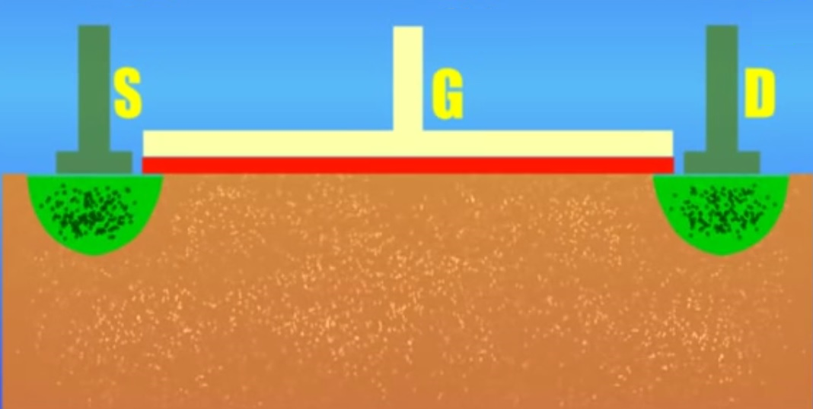
CS220 Computer Architecture Digital Logic Design
How a transistor works
Silicon doped with Phosphorous
n-type
Silicon doped with Boron
p-type
Silicon doped with Phosphorous
n-type
The semiconductor transistor consists of three layers of semiconductor material. Either a slice of p-type is sandwiched between two n-type materials (as shown above) or a slice of n-type is sandwiched between two p-type materials. The transistor has three electrical terminals known as the source, drain and the gate. The gate controls the flow of current between the source and drain. If current flows the switch is open, if it doesn’t the switch is closed.

Slide 18
CS220 Computer Architecture Digital Logic Design
How a transistor works
n-type
p-type
barrier
When n-type and p-type are placed in proximity, electrons from the n-type naturally fill some of the holes in the p-type, and this creates a barrier, a negatively charged area between the two types known as the depletion layer and further electrons will not flow through it from the n-type to the p-type without help.

Slide 19
CS220 Computer Architecture Digital Logic Design
How a transistor works
n-type
p-type
barrier
To overcome this, the inner terminal, called the gate, is used. The other two terminals are called the source and the drain. By applying a voltage to the gate, the inner layer of p-type doped silicon is made to conduct and this allows current to flow between the source and the drain. Voltage on the gate attracts or pulls electrons through the depletion layer barrier and creates a channel between source and drain through which electrons flow.

Slide 20
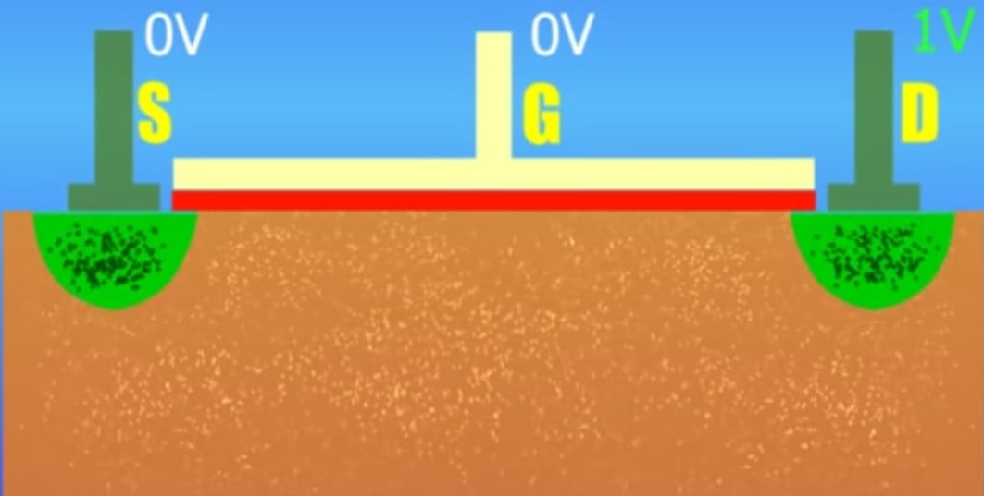
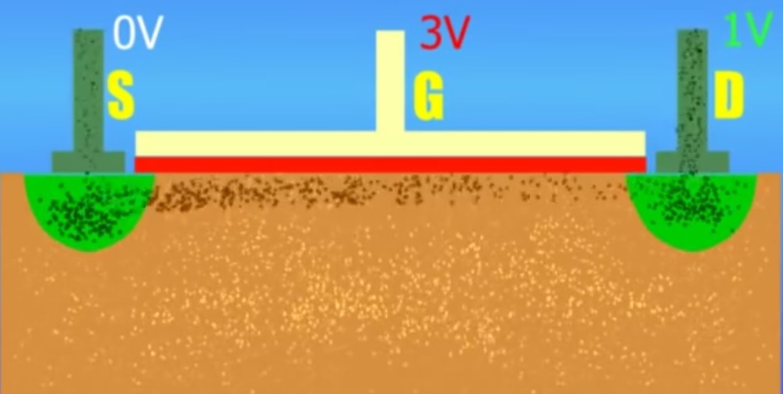
CS220 Computer Architecture Digital Logic Design
n-type CMOS
Gate inactive, Transister off, no electron flow between source and drain
n-type semiconductor
material
No Electron Flow
p-type semiconductor
material
How a transistor works
Gate active, Transister on, electrons flow between source and drain
Electron Flow

Slide 21

CS220 Computer Architecture Digital Logic Design
Operation of a Transistor Switch
A transistor switch can be opened or closed by applying a control voltage to its Gate terminal. This controls the current flowing between the Drain and the Source terminals. There are two main types of transistor, referred to as n-type and p-type.
With n-type transistors, when no voltage (GrouND) is applied to the Gate, the transistor acts as an open switch, disconnecting the Drain and Source. When a voltage (say 3V) is applied to the Gate, the transistor acts as a closed switch connecting the Drain and the Source. A p-type device works in the opposite(complementary) way for voltages applied to its gate.

Slide 22
CS220 Computer Architecture Digital Logic Design
Using Transistors to Implement Boolean Operations
Boolean algebra defines a set of logical operators for manipulating binary values and allows us to express complex circuit functionality in simple algebraic terms.
The three most basic operations defined in Boolean Algebra are AND, OR and NOT.
We will define the behaviour of these operators using Truth Tables and demonstrate how the AND, OR and NOT operators can be implemented using transistors. We will look at how another operator, the EXOR operator, can be constructed from these logic operators and how generally these basic operators will form the building blocks for circuit design.

Slide 23

CS220 Computer Architecture Digital Logic Design
Implementing Boolean Operations
The NOT operator (inverter)
The behaviour of the NOT operator is defined by a truth table which lists the output values of the gate for all possible input combinations:-
Single Input Operator

Slide 24
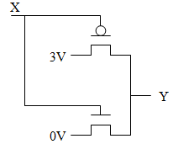
CS220 Computer Architecture Digital Logic Design
Implementing Boolean Operations
The NOT operator (inverter)
When a high signal (+3V) is connected to X, the n-type transistor switch(bottom) closes placing 0V at Y. When a low signal (0V) is connected to X, the p-type transistor(top) closes placing 3V at Y. The output at Y is always the opposite(complement) to the value of X in the circuit above.
This circuit is known as an inverter.
The input signal X is connected to the gates of an n-type and p-type transistor producing the inverted output Y :-
p-type
n-type

Slide 25

CS220 Computer Architecture Digital Logic Design
Implementing Boolean Operations
In logic design we represent the NOT gate, or inverter, with the following symbol.

Slide 26
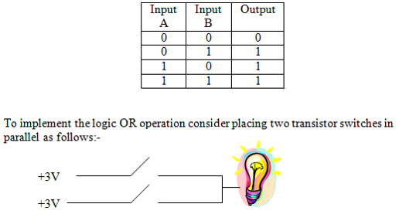
CS220 Computer Architecture Digital Logic Design
Implementing Boolean Operations
The OR operator
The OR operator combines two boolean values into one.
In Boolean Algebra, the behaviour of the OR operator is defined by the following truth table:-

Slide 27

CS220 Computer Architecture Digital Logic Design
Implementing Boolean Operations
The OR operator
Either switch needs to be on to turn on the light bulb. The transistor gates represent the circuit inputs. By applying a low or high voltage to the gate of each transistor determines whether current can flow to the light bulb. Assuming n-type transistors are used, current can only flow to the light bulb if either one or both of the gates have a high voltage signal.

Slide 28

CS220 Computer Architecture Digital Logic Design
Implementing Boolean Operations
The OR operator
In logic design, the OR gate is represented by the following symbol:-

Slide 29
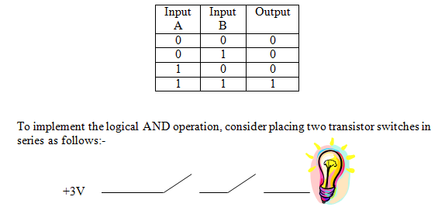
CS220 Computer Architecture Digital Logic Design
Implementing Boolean Operations
The AND operator
The AND operator also combines two boolean values into one.
In Boolean Algebra, the behaviour of the AND operator is defined by the following truth table:-

Slide 30


CS220 Computer Architecture Digital Logic Design
Implementing Boolean Operations
The AND operator
Both switches must be on in order to turn on the light. The transistor gates represent the circuit inputs. By applying a low or high voltage to the gate of each transistor determines whether current can flow to the light bulb. Assuming n-type transistors are used, current can only flow to the light bulb if both of the gates have a high voltage signal.
In logic design, the AND gate is represented by the following symbol:-

Slide 31
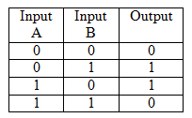
CS220 Computer Architecture Digital Logic Design
Implementing More Complex Functions
We can use the three basic boolean operators AND, OR and NOT in combinations to construct other operators and functions.
For example, The XOR operator (Exclusive OR)
XOR is a useful function for arithmetic related operations as we will see later.
The behaviour of the XOR operator is defined by the following truth table:-
It is different to the OR operator in that when both inputs are logic 1, the output is defined to be logic 0.

Slide 32

CS220 Computer Architecture Digital Logic Design
Implementing Boolean Operations
The XOR operator
The XOR operator is represented by the following logic symbol:-
The functionality of an XOR gate can be expressed in terms of AND, OR and NOT as follows:-

Slide 33
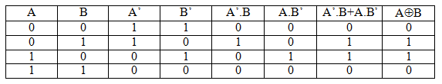
CS220 Computer Architecture Digital Logic Design
Implementing Boolean Operations
The XOR operator
This boolean expression can be proven by using a truth table, as shown below.
From xor definition
.
+
First list all the input combinations of
A and B
Then derive their
complements
Create columns to
derive
subexpressions
The final two columns have the same values so their expressions must be equal

Slide 34
CS220 Computer Architecture Digital Logic Design
Summary
Electrical switches can be used to create circuits for computing functions.
A semiconductor transistor can act as a miniature switch.
Transistor switches can be grouped and arranged to make simple boolean logic operators.
Boolean operators can be combined to create more complex circuit functionality.
Complex circuit functionality can be designed, manipulated and simplified using Boolean Algebra.

Slide 35
CS220 Computer Architecture Digital Logic Design
Boolean Algebra
Boolean Algebra defines a set of laws, operations and theorems on the set of elements {0, 1}.
We need to understand the basics of Boolean Algebra to specify circuit behaviour and manipulate implementations.
In this section we look at some of the basic operations, definitions and terms, laws, and theorems of Boolean Algebra and how they can be applied in the simplification of expressions.

Slide 36
CS220 Computer Architecture Digital Logic Design
Things we can do with Boolean Algebra
Algebra will allow us to describe a circuit as a mathematical expression, as a functional specification of how its outputs behave in response to its inputs.
It will allow us to manipulate the functional specification for the purposes of simplification of a circuit reducing the number of logic gates (cost/power/space) required to implement it.
Algebra will help us substitute alternative implementation solutions for circuits or parts of circuits that may require using certain types of logic gates.

Slide 37
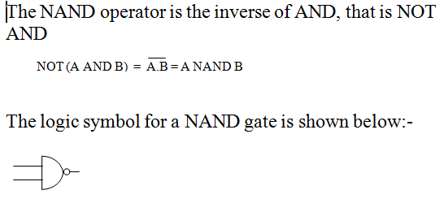
CS220 Computer Architecture Digital Logic Design
First - Some additional Boolean Operators
We have already defined the operations AND, OR and NOT of the algebra.
Additionally, the following operations are easily derived from these:-
NAND

Slide 38
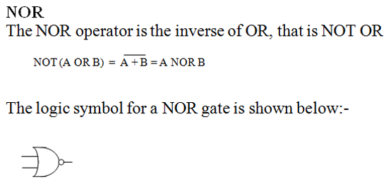
CS220 Computer Architecture Digital Logic Design
First - Some additional Boolean Operators
NOR

Slide 39
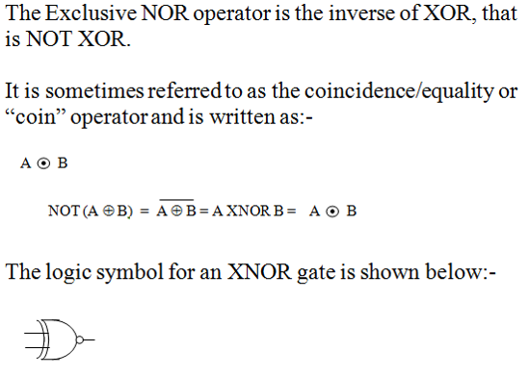
CS220 Computer Architecture Digital Logic Design
First - Some additional Boolean Operators
XNOR

Slide 40
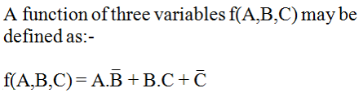

CS220 Computer Architecture Digital Logic Design
Boolean Functions and Syntax
A Boolean function consists of a number of Boolean variables joined by Boolean operators. For example:-
Commonly, the symbol for AND (DOT) is assumed to exist between adjacent variables and the function can be written omitting the DOT:-

Slide 41

CS220 Computer Architecture Digital Logic Design
Definition
The Dual of a function is obtained by changing the AND operators to OR and vice versa and any 1’s to 0’s and vice versa. The variables are left unchanged.
Say we have a function:-

Slide 42
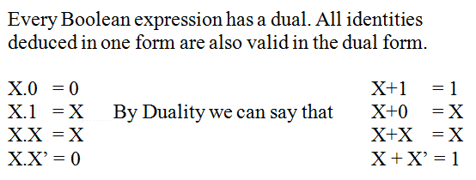
CS220 Computer Architecture Digital Logic Design
Principle of Duality

Slide 43
CS220 Computer Architecture Digital Logic Design
Definitions
Two functions are equivalent provided they generate the same output values for each of the possible combinations of the input variables.
Two functions are complementary provided they generate the opposite output values to each other for each of the possible combinations of the input variables.
One quick technique for obtaining a complement expression for a function is to complement each variable in the dual of that function.

Slide 44
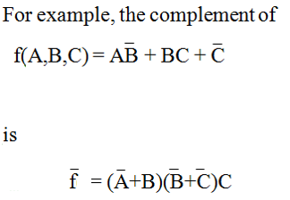
CS220 Computer Architecture Digital Logic Design
Example: Complementing Boolean Functions using the dual form
First get the dual by switching
ANDs to ORs and ORs to ANDs.
Then get the inverse of the
original function by
inverting all the variables
in the dual expression.

Slide 45
CS220 Computer Architecture Digital Logic Design
Boolean Functions
Operator Precedence
When evaluating an expression:-
1. Terms in parenthesis are evaluated first from the deepest level of parenthesis outwards.
2. The NOT operator is applied as soon as its operand is evaluated.
3. The AND operator is always performed before OR unless overridden by parenthesis.

Slide 46

CS220 Computer Architecture Digital Logic Design
Definition - Complete Gate Sets
A collection of operators that can, on their own, be combined to express any Boolean function is a complete set. All Boolean functions can be expressed in terms of AND, OR and NOT operators.
For example, any Boolean function can in fact be expressed using only AND and NOT operators. This is because AND and NOT can be used to implement OR as follows:-
Derived from DeMorgan’s Law

Slide 47

CS220 Computer Architecture Digital Logic Design
Complete Gate Sets
Similarly, any Boolean function can in fact be expressed using only OR and NOT operators. This is because OR and NOT can be used to implement AND as follows:-
Derived from DeMorgan’s Law

Slide 48

CS220 Computer Architecture Digital Logic Design
Complete Gate Sets
In fact, the derived operator NAND is a complete set in itself as a NAND with both inputs tied together acts as a NOT (inverter) and two NANDs can be made to function as an AND as shown below:-

Slide 49

CS220 Computer Architecture Digital Logic Design
Complete Gate Sets
Similarly the derived operator NOR is a complete set in itself.
A NOR with both inputs tied together acts as a NOT (inverter) and two NORs can be made to function as an OR as shown below.
This means that all Boolean functions can be implemented entirely using only NAND gates or alternatively NOR gates.

Slide 50
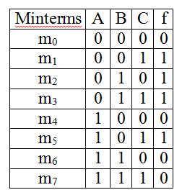
CS220 Computer Architecture Digital Logic Design
Truth Tables
A truth table is a method of describing a Boolean function. It contains a row for every combination of the variables involved and gives the value of the function for each of these possible combinations.
For the three variable function f(A,B,C) whose truth table appears above there are 2³ combinations of the variables and the value of the function for each of these combinations is listed.

Slide 51

CS220 Computer Architecture Digital Logic Design
Truth Tables
The Boolean function described by the truth table is provided by the logical sum of those combinations for which the function has a value of f=1.
Each product of the variables (or row in the table) is called a minterm and the function tabulated in the truth table can be described as a sum of minterms so that:-
f = Σm₁m₂m₃m₅

Slide 52
CS220 Computer Architecture Digital Logic Design
Sum-of-products
A Boolean function expressed as a sum of minterms is termed the sum-of-products form of the function.
f = Σm₁m₂m₃m₅
which we might abbreviate to:-
f = Σ 1,2,3,5

Slide 53

CS220 Computer Architecture Digital Logic Design
Truth Tables and Inverse Functions
The inverse function is obtained by taking the logical sum of those combinations for which f = 0.
From the truth table we have:-

Slide 54


CS220 Computer Architecture Digital Logic Design
Principle of Duality
We can obtain an alternative expression for the function of f by using the principle of duality:-
Original expression for f from truth table
Original expression for inverse function f from truth table:-
Alternative expression for the original function f above, by getting the dual of the inverse function and then inverting the variables.

Slide 55
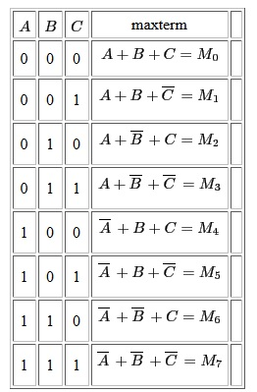
CS220 Computer Architecture Digital Logic Design
Each term in this equation is called a maxterm and the Boolean function is expressed as a product of maxterms by choosing maxterms associated with rows where the function value is 0.
The resulting expression is called the product-of-sums and may be written as:-
f = ∏ M₀M₄M₆M₇
or abbreviated as
f = ∏ 0,4,6,7

Slide 56
CS220 Computer Architecture Digital Logic Design
Every Boolean function can be expressed as a product of sums or as a sum of products of its input variables. i.e. in TWO LEVEL GATE FORM.
A minterm is a product combination “.” of the direct or complemented values of the input variables. A minterm has the property that it is equal to 1 on exactly one row of the truth table.
A maxterm is a sum combination “+” of the direct or complemented values of the input variables. A maxterm has the property that it is equal to 0 on exactly one row of the truth table.

Slide 57
CS220 Computer Architecture Digital Logic Design
A truth table provides a simple way of understanding the operation of a function, however, truth tables are of limited use for representing more complex Boolean functions as the number of rows in the table for an n-variable function is 2^{n}.
As n gets larger, the construction of the table becomes tedious, time consuming and is prone to error.

Slide 58
CS220 Computer Architecture Digital Logic Design
Boolean Theorems
Sometimes it is easier to use algebraic methods to manipulate function expressions.
The following theorems, which are easily proven with truth tables using perfect induction (proof by exhaustion) are useful for algebraic manipulation and reduction of Boolean expressions.

Slide 59
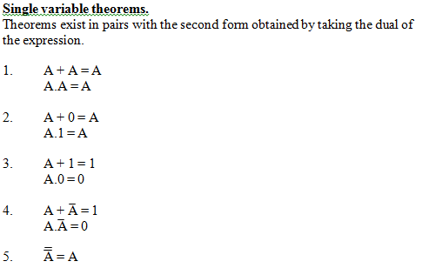
CS220 Computer Architecture Digital Logic Design

Slide 60
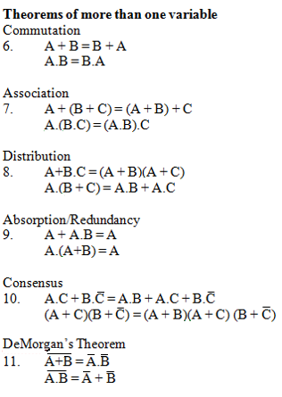
CS220 Computer Architecture Digital Logic Design

Slide 61
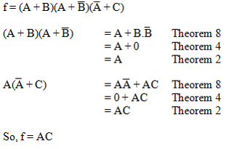
CS220 Computer Architecture Digital Logic Design
Simplification of Expressions
Exercise - Simplify the following expression:-
In terms of circuit complexity, we have reduced the implementation from 7 logic gates/operators to just 1 AND operation using Boolean Algebra.

